Slide 1
Greenland: A Secure Land Registration Scheme for Blockchain and AI-Enabled Agriculture Industry 5.0

Slide 2
Abstract
The Greenland framework introduces a secure and intelligent land registration system integrating Blockchain and Artificial Intelligence (AI) to meet the demands of Agriculture Industry 5.0. Traditional land registration systems, reliant on centralized servers, are prone to data tampering and lack transparency. Greenland addresses these issues through a decentralized Blockchain-based infrastructure that ensures tamper-proof, encrypted storage of land transaction data, utilizing IPFS (InterPlanetary File System) for scalable and secure data handling.
Smart contracts, developed using Solidity, are deployed on the Ethereum Blockchain to manage buyer, seller, and transaction metadata. AI algorithms are integrated to detect fraudulent land transactions by analyzing Blockchain raw data.

Slide 3
Introduction
The agriculture sector is undergoing a transformative evolution towards Industry 5.0, where technologies like Artificial Intelligence (AI) and Blockchain converge to enhance transparency, efficiency, and trust. One critical challenge within this paradigm is the secure and tamper-proof management of land registration—a foundational component in agricultural operations and land ownership authentication.
Greenland presents a novel, secure land registration system that leverages Blockchain’s decentralized ledger and AI-powered fraud detection to overcome the vulnerabilities of traditional, centralized land record systems. Conventional approaches are susceptible to manipulation by database administrators and lack real-time validation mechanisms.

Slide 4
literature survey
1. Secure Decentralized Land Registration Using Blockchain
Traditional land registration systems rely on centralized databases that are prone to tampering by administrators.
The proposed scheme leverages blockchain’s decentralized, tamper-proof, and encrypted data storage to secure land registration records.
Smart contracts written in Solidity are used to automate and secure land transactions.
2. AI-Based Fraud Detection in Land Transactions
AI algorithms are employed to detect fraudulent land transactions from blockchain data (sender, receiver, transaction type, etc.).
The AI models are trained on real-world Ethereum fraud datasets to identify suspicious patterns.

Slide 5
Existing System
Traditional land registration systems are largely centralized, relying on local government servers or administrative databases. These centralized structures are highly vulnerable to tampering and unauthorized modifications by internal administrators or malicious actors. The lack of transparency, immutability, and decentralized control makes it difficult to trace fraudulent transactions or ensure the authenticity of ownership records. Moreover, current systems do not incorporate intelligent mechanisms to detect anomalies or fraud, leaving the process open to human error and manipulation. These deficiencies highlight the urgent requirement for a more secure, transparent, and intelligent solution to manage land records effectively, especially as agricultural sectors adopt Industry 5.0 practices that demand trust, automation, and data-driven insights.

Slide 6
Drawbacks
• Centralized Databases:
Vulnerable to tampering by administrators.
Single point of failure leads to potential data breaches or manipulation.
• No Transparency:
Transactions and ownership details lack public traceability or auditability.
Disputes over land ownership are common due to unclear or falsified records.
• Manual Verification:
Time-consuming and error-prone verification processes.
High dependency on human judgment which may be biased or corrupt.

Slide 7
Proposed System
The proposed “Greenland” system integrates Blockchain and Artificial Intelligence to create a secure, transparent, and intelligent land registration framework tailored for Agriculture Industry 5.0. Blockchain provides decentralized, tamper-proof data storage with built-in cryptographic security, ensuring that land records remain immutable and trustworthy. Simultaneously, AI and Machine Learning algorithms (e.g., LightGBM, XGBoost, SVM) are employed to detect fraudulent transactions from Blockchain raw data, enhancing the system’s ability to automatically flag suspicious activities. Through smart contracts and IPFS (Interplanetary File System), the system supports decentralized storage and automated data retrieval. Web modules for buyers and sellers facilitate seamless interaction, while ML predictions guide decision-making in real-time.

Slide 8
Advantages
1. Tamper-Proof Land Registration
Blockchain technology ensures decentralization and immutability.
Land records cannot be altered or deleted, protecting ownership from fraud.
2. Fraud Detection with AI/ML
Advanced AI models (e.g., LIGHTGBM, XGBOOST, SVM) are trained to detect fraudulent transactions.
The system achieved up to 99.35% accuracy in fraud detection using Ethereum transaction datasets.

Slide 9
HARDWARE REQUIREMENTS:
System : i3
Hard Disk : 250 GB
RAM : 4 GB

Slide 10
SOFTWARE REQUIREMENTS:
Operating system : Windows Family
Coding Language : Python

Slide 11
Modules
1. Blockchain and Smart Contract Deployment
2. IPFS Server Integration
3. AI/ML-Based Fraud Detection
4. Web Application Modules

Slide 12
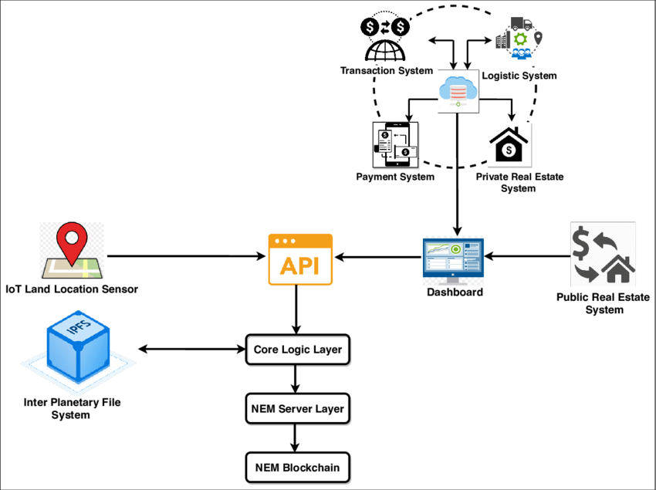
System Architecture:

Slide 13
UML
Class Diagram:

Slide 14
Use case Diagram:

Slide 15
Sequence Diagram:

Slide 16
Collaboration Diagram:

Slide 17
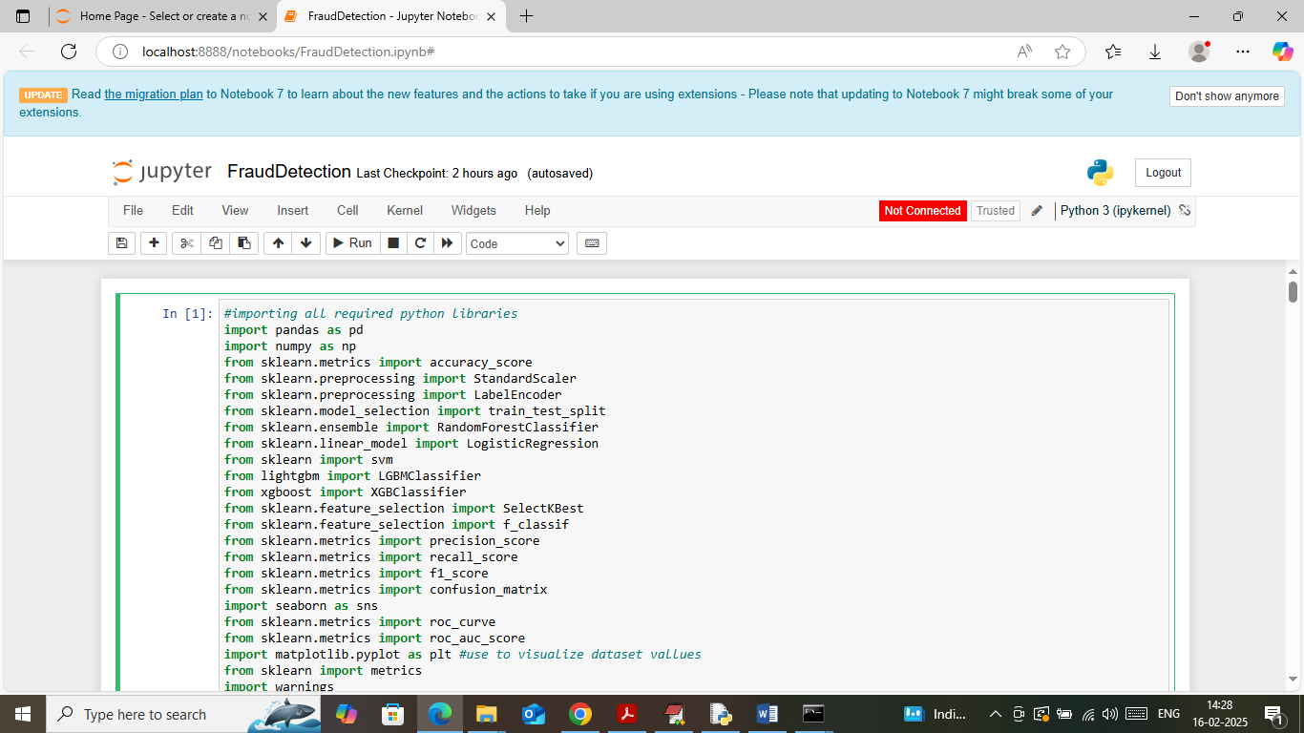

Slide 18
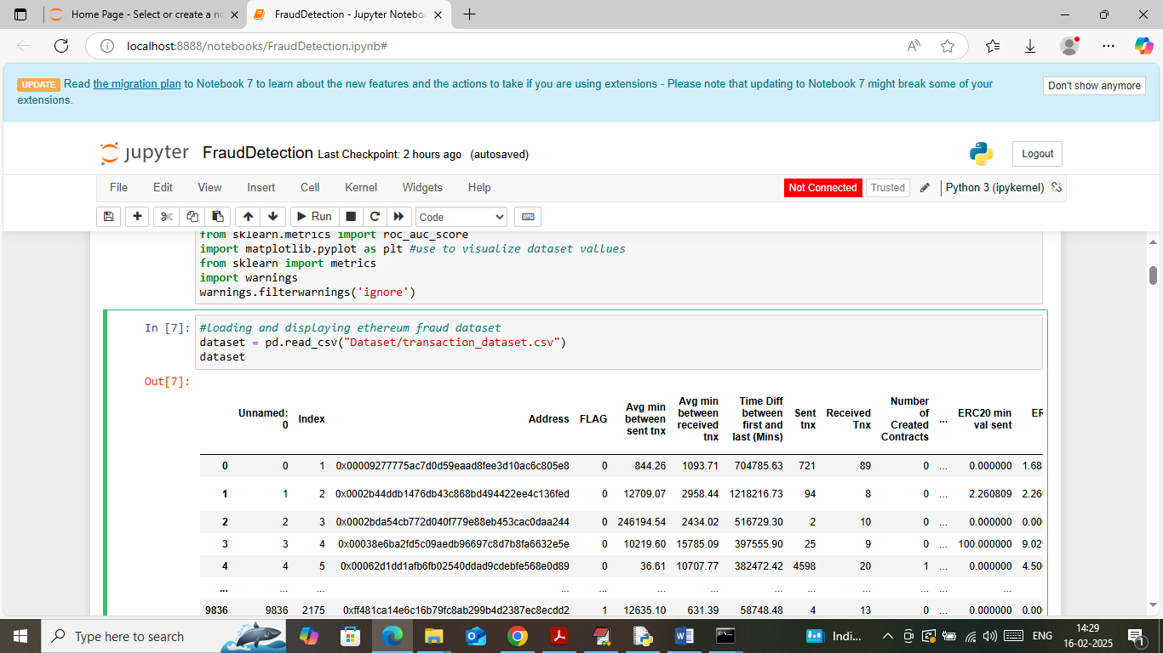

Slide 19
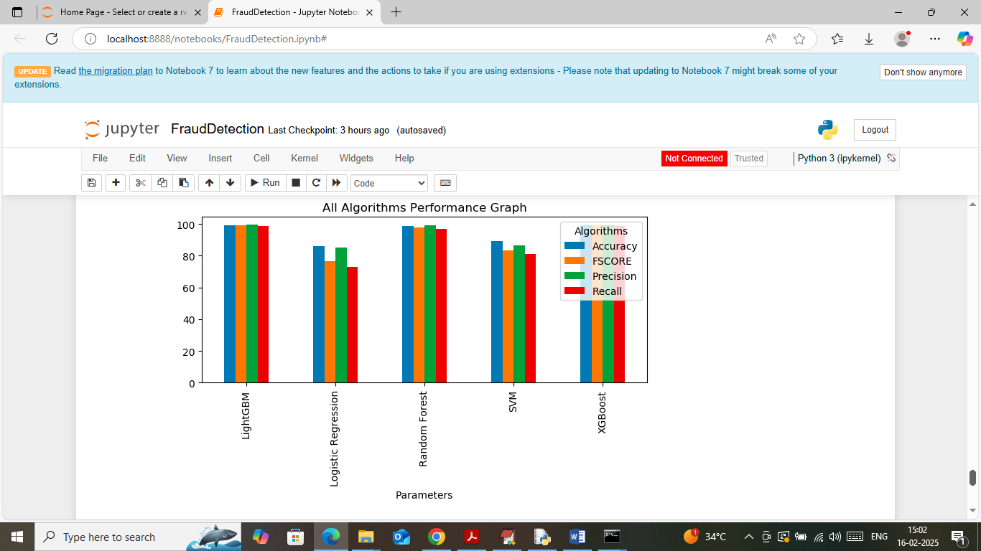

Slide 20
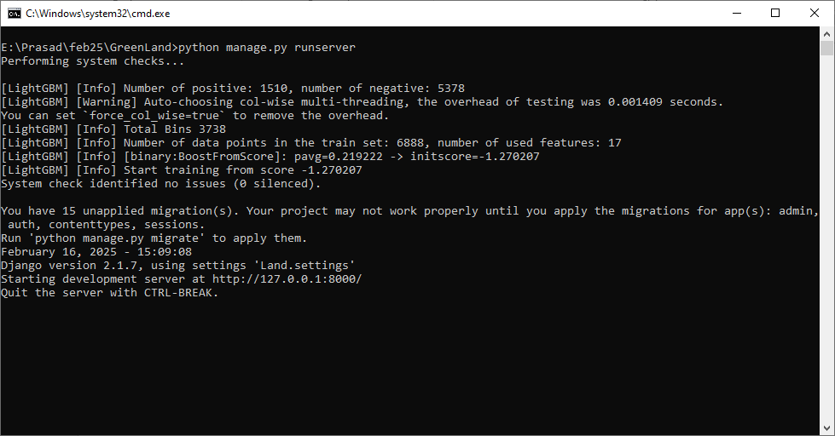

Slide 21
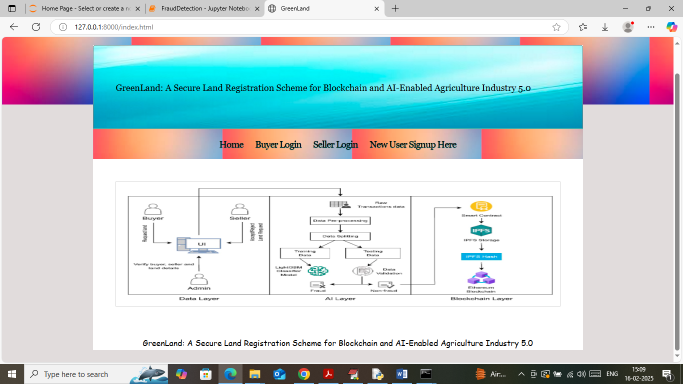

Slide 22
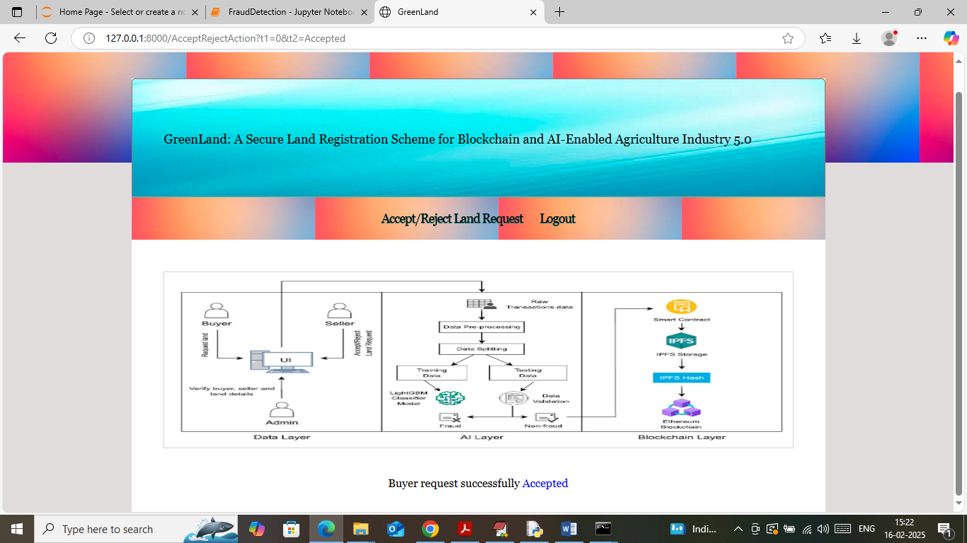

Slide 23
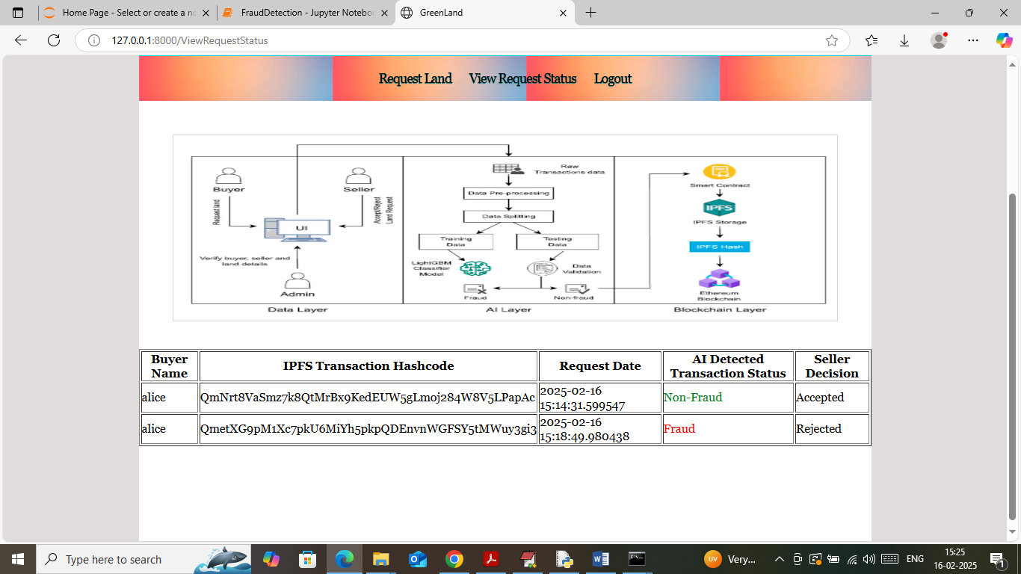

Slide 24
Conclusion
The proposed Greenland framework successfully demonstrates a secure, decentralized, and AI-augmented approach to land registration for Agriculture Industry 5.0. By integrating blockchain technology, particularly Ethereum smart contracts, and IPFS-based distributed storage, the system ensures data integrity, tamper-proof ownership records, and transparent land transactions. Additionally, the implementation of various machine learning models — including Logistic Regression, SVM, Random Forest, XGBoost, and LightGBM — enables the real-time detection of fraudulent transactions using historical Ethereum data. Among these, LightGBM achieved the highest accuracy, validating its effectiveness in identifying irregularities in land registry data.

Slide 25
Future work
Scalability Across Jurisdictions: Future research could explore how the framework can be adapted to support country-specific land governance policies and legal compliance across different jurisdictions.
Incorporation of Satellite and IoT Data: Integrating real-time geospatial data and IoT sensors into the blockchain can further verify land usage patterns and support precision agriculture.
Advanced AI Techniques: Employing deep learning models and graph-based algorithms could improve fraud detection capabilities, especially for complex transaction networks.

Slide 26
Reference
• Kshetri, N. (2018). 1 Blockchain’s roles in meeting key supply chain management objectives. International Journal of Information Management, 39, 80-89.
• Zhang, Y., Kasahara, S., Shen, Y., Jiang, X., & Wan, J. (2019). Smart Contract-Based Access Control for the Internet of Things. IEEE Internet of Things Journal, 6(2), 1594-1605.
• Reyna, A., Martín, C., Chen, J., Soler, E., & Díaz, M. (2018). On blockchain and its integration with IoT. Challenges and opportunities. Future Generation Computer Systems, 88, 173-190.

Slide 27
THANK YOU

